Slide 1


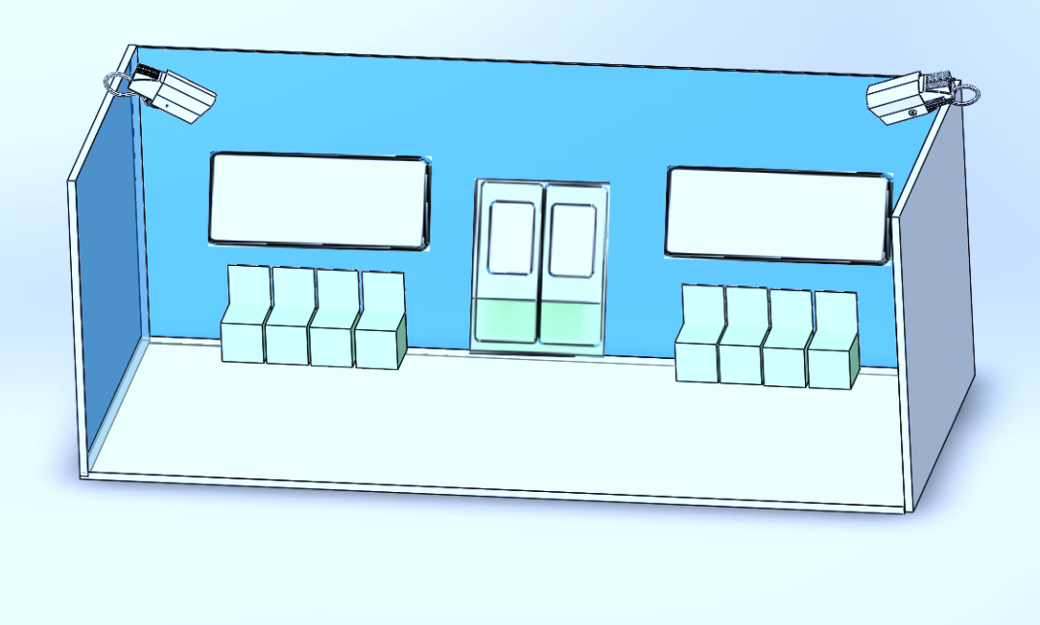
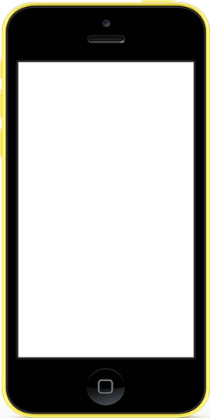



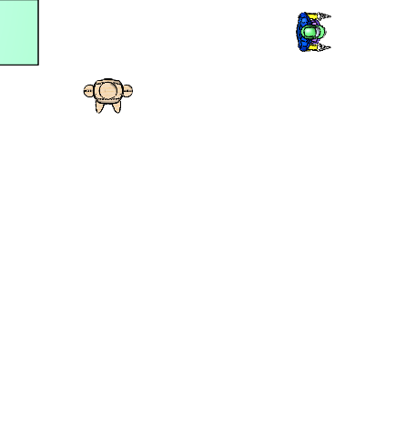
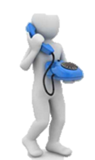
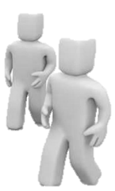


Team 9 V i t a s
Tao Yuanjie Zhang Ziyi
Liu Jiachen Ding Kaiwen
Line 8 Carriage 5
Carriage
Line 8
Carriage 5
Num:
6
The Real-Time Determination
Of Numbers of Passengers
Symposium for Project No. 2
July 29th 2017
1
1

Slide 2


Contents
1
Introduction
4
Budget&Risk
Objectives
Result
2
5
Solution&Task
Conclusion
3
6
2
Notes:
目录

Slide 3
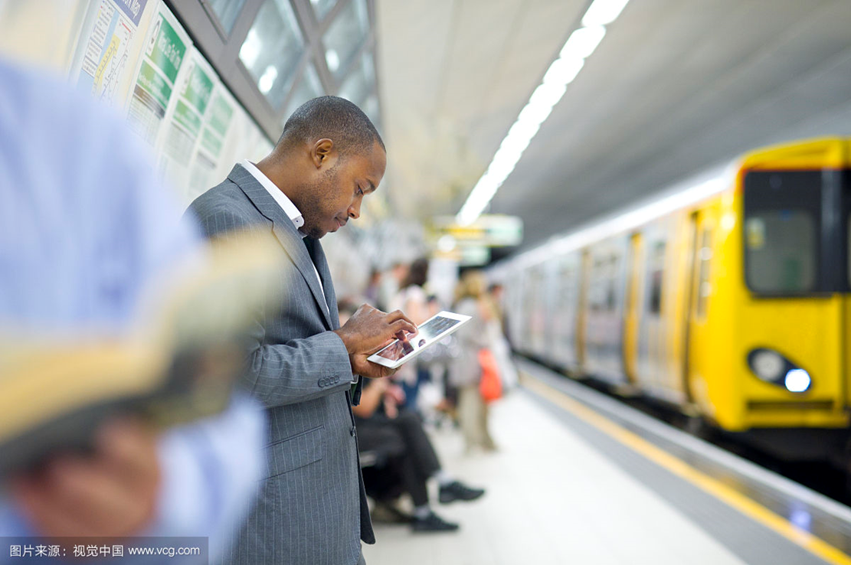
Problem
24,150,000
9,280,000
9,280,000 citizens take subways as their main transportation in Shanghai.
3

Slide 4
Our Stakeholder
Operators
Passengers
Other walks of life……
4

Slide 5
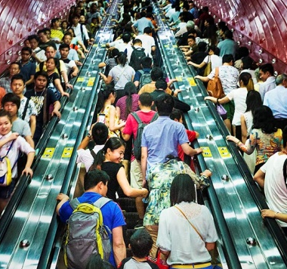
Problem
Crowd Balancing
Comfortable Travel
强大功能为您所用
强大功能为您所用
Where is relatively crowded ?
Where is relatively crowded ?
Public Safety
Others…
5
5
Notes:
Stakeholder

Slide 6
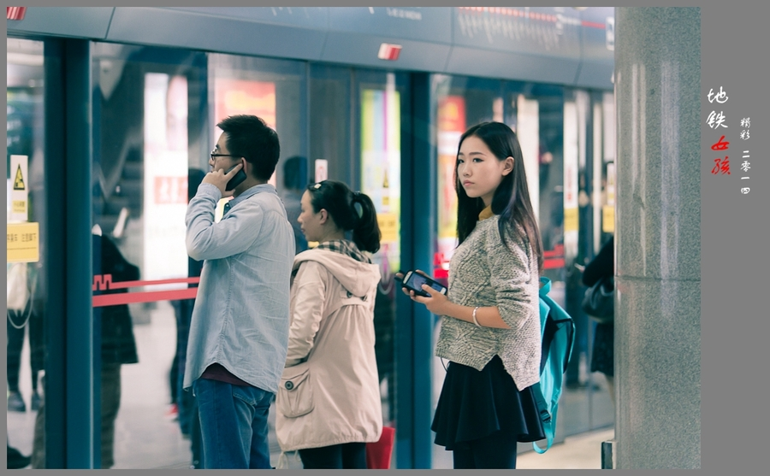
Problem
NO existing system can share the real-time number of people!
6

Slide 7

Criteria
Accurate
Real-time
Affordable
7
Notes:
图标换掉

Slide 8

Constraints
Accuracy
The variety of human and environment
Technology
The complicated algorithm and mathematical principles
8
8
Notes:
图标换掉

Slide 9


Contents
1
Introduction
4
Budget&Risk
2
Objectives
Result
5
Solution&Task
Conclusion
3
6
9
9

Slide 10
Design
Method
Objective I
Place Cameras on the ceiling
Cameras
Obtain the Whole picture
Determine the accurate passenger flow
Light source
Conduct Image processing
Offer stable Light source
Identify human Heads
10
10

Slide 11

Method
Objective II
Upload the data onto the Internet
Analyze & Share the Big Data
Analyze the history data
Share information on
mobile terminal
11
11
Notes:
历史数据对应 提高公共设施合理利用率+公众安全
移动终端对应 高效出行

Slide 12
Block Diagram
Image
Processing
Camera
Data Transmission
Metro
Operators
Other
public area
Customers
Machine
Learning
Image
Acquisition
12
Notes:
联系 说出来

Slide 13
Contents
1
Introduction
4
Budget&Risk
Objectives
Result
2
5
3
Solution&Task
Conclusion
6
13
13

Slide 14

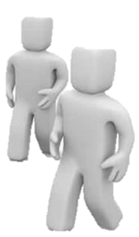
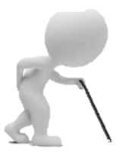
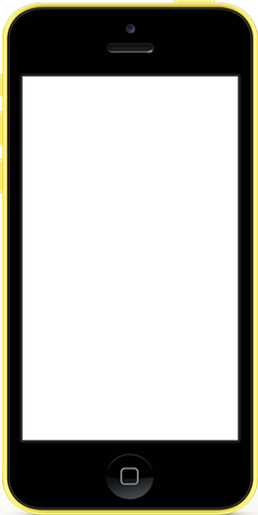
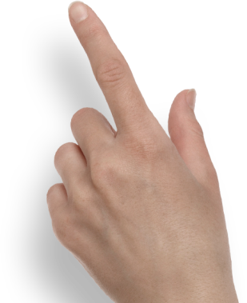

Solution
Line 8 Carriage 5
Carriage
Line 8
Carriage 5
Num:
6
14
14
Notes:
Take picture
Do the image processing
Share the data on the mobile devices

Slide 15
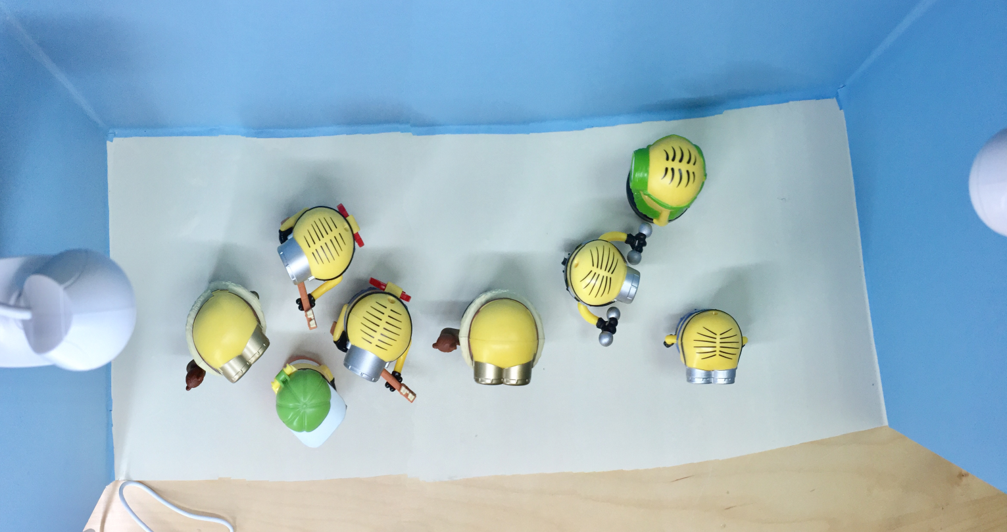
Solution
I
Image Processing
15
15
Notes:
Integrate the whole picture and eliminate the overlapping part
To get the whole picture

Slide 16
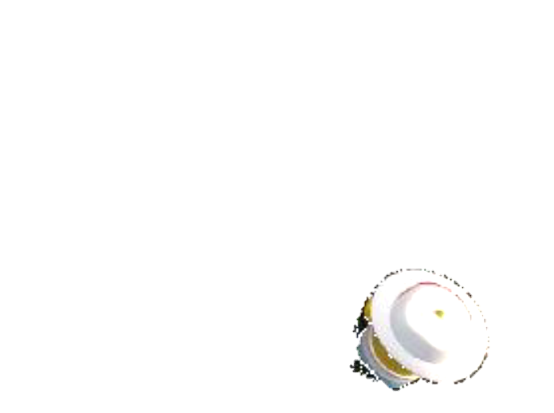
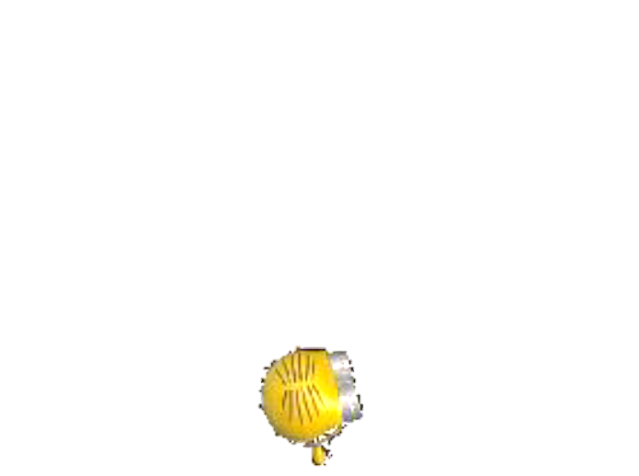
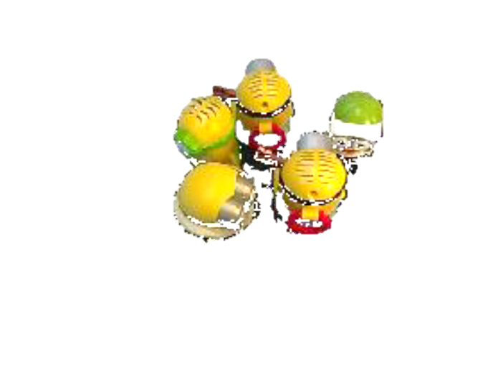
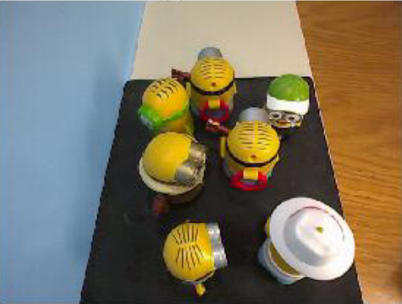
Solution
II
Remove Background
16
Notes:
Reduce the error caused by the background
Transfer the image to the data that our computer can process

Slide 17
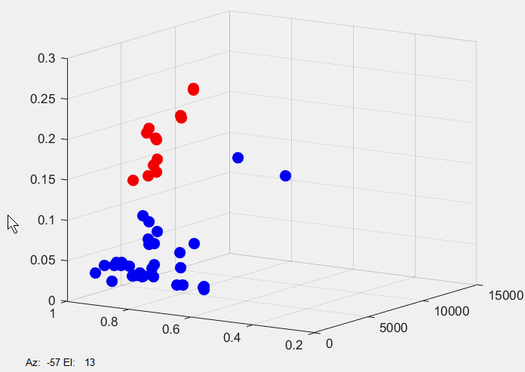

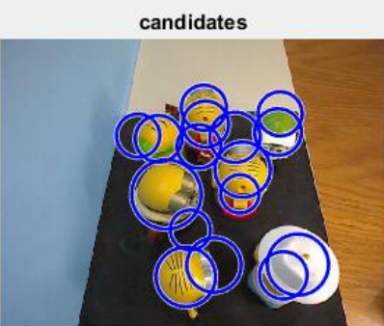



Solution
Arc → Circle
Arc → Circle
Color
Shape
Size
Yellow → Red
Yellow → Red
III
Machine Learning
17
17
Notes:
Only based on ………… cannot ensure the accuracy of human’s heads， candidate
Actually, our identification system is more intelligent
We use the method of machine learning to double our accuracy
And I will brief introduce the basic principle
Suppose the computer is a baby and have no idea about fruits
And you are her mother, to teach her how to identify the apples and banana.
You told her that the apples are round and red most of time. So do the bananas
After several times you told her…….
She may has the ability to identify them itself!
In fact, in our algorithm, the computer set up a graph ,x-axis……….y-axis…………
By putting the history data into the graph , it can set up its data base. And fit a boundary to separate these two fruits
We apply the similar ………..actually, we use 5 –d to fit a surface in a higher d space
In this way, our accuracy is greatly improved.
That is why our identification has high transportabilty
Apart from identifying heads, we can apply the same principle to count the number of other objects based on different data base

Slide 18
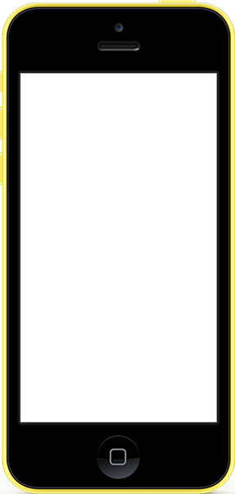


Solution
Upload the Big Data
The number of people
in each
Carriage & area
Line 8
17：04
2
7
6
1
3
4
5
8
9
10
6
Carriage 5
II
Data Transmission
18
18
Notes:
Generate the big data
And use computer to analyze it
finally
The useful result can be shared to passengers and metro operators

Slide 19
Task
Create data base and improve
5
Transfer the data
4
Process image
3
Assemble the model
2
Objective II
Share the data
1
Market research
Objective I
Determine the passenger flow
19
19
Notes:
详细

Slide 20
Task I
Market research
20
20

Slide 21
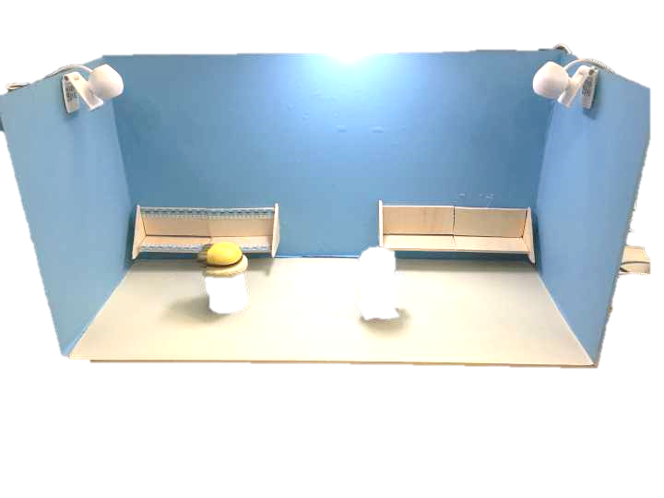
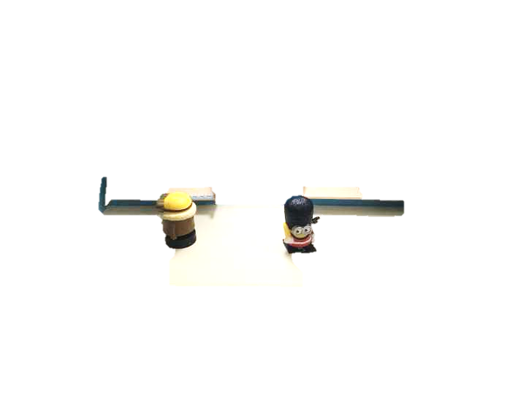
Task II
Assemble the model
21
21

Slide 22
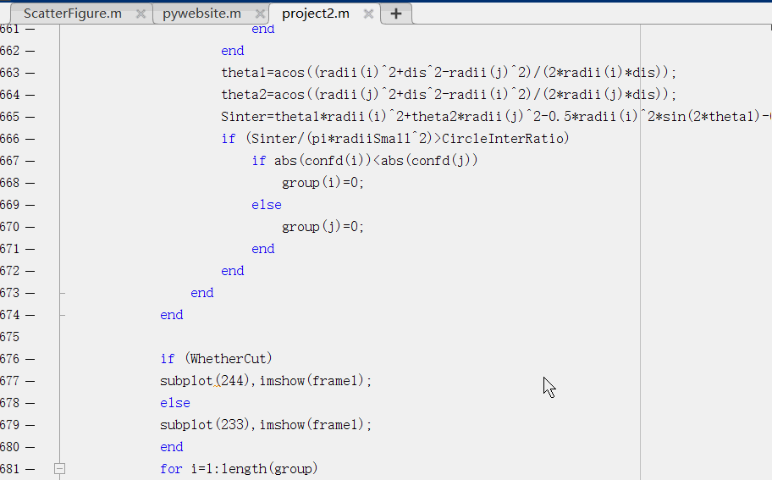
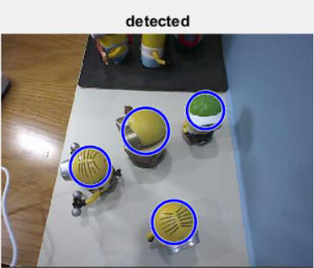
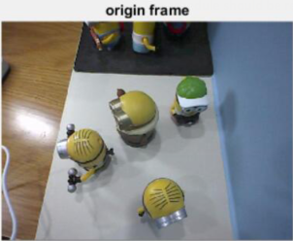
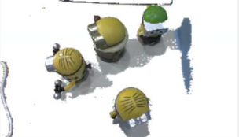
Task III
Process image
22
22

Slide 23
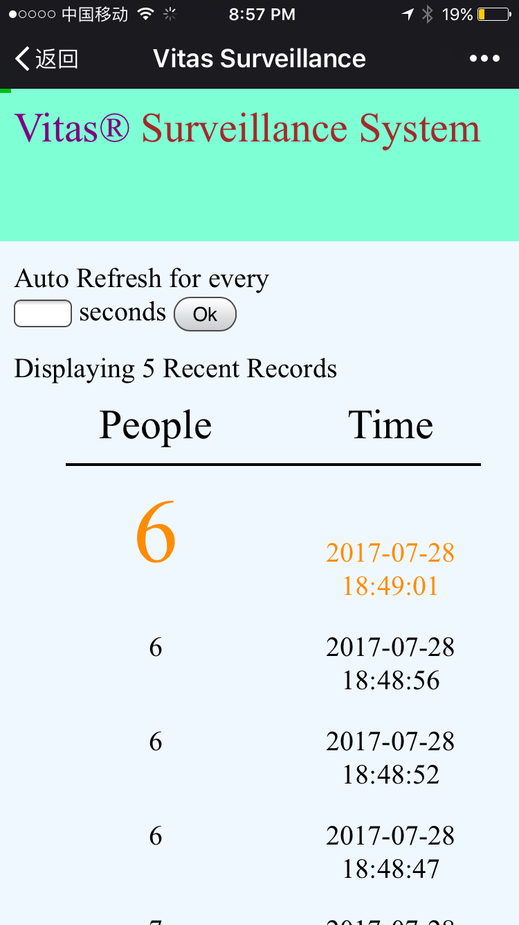

Task IV
Transfer the data
23
23

Slide 24
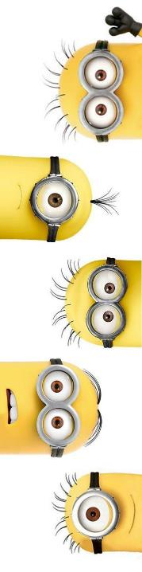



Task V
Create data base and Improve
24
24

Slide 25
Schedule
25
25
Notes:
分工

Slide 26
Contents
1
Introduction
4
Budget&Risk
Objectives
2
5
Result
3
Solution
Conclusion
6
26
26

Slide 27
Budget
No. | Item | Specification | Quantity | Unit Price (￥)
1 | Camera | 640×480 | 2 | 19.9
2 | LED tube | 0.3m/4W | 2 | 18.8
3 | Acrylic board | 300mm×250mm | 2 | 11.67
4 | Acrylic board | 600mm×300mm | 1 | 28
5 | Acrylic board | 600mm×250mm | 2 | 23.33
6 | Dummy model | 6cm×6cm×9cm | 15 | 8.4
 |  |  | Total | 301.4
27
27
Notes:
物美价廉
科技改变生活

Slide 28
Risk
Head Overlapping
Adjust the camera position
Optimize image segmentation
28
28

Slide 29
Risk
The Light Condition
Head Overlapping
Apply indoors
Provide stable light source
Keep Improving !
29
29

Slide 30
Contents
1
Introduction
4
Budget&Risk
Objectives
Result
2
5
3
Solution&Task
Conclusion
6
30
30

Slide 31
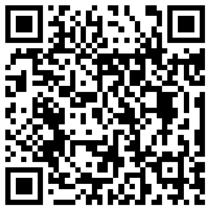

Results
31
31

Slide 32
Contents
1
Introduction
4
Budget&Risk
Objectives
Result
2
5
Solution
Conclusion
3
6
32
32

Slide 33
Conclusion
Huge market
Accuracy
Cost performance
Real-time data
Transportability
33
33

Slide 34
Thank You for attention
Q&A
34

